Slide 1
#Situated Biology
CSC 591 User Experience project
Spring 2018
Guided by: Dr. Benjamin Watson | Client: Dr. Terry Gates

Slide 2
Agenda
Objective
Problem
Solution
5 Stages
Includes live demo
Recommendations
Questions

Slide 3
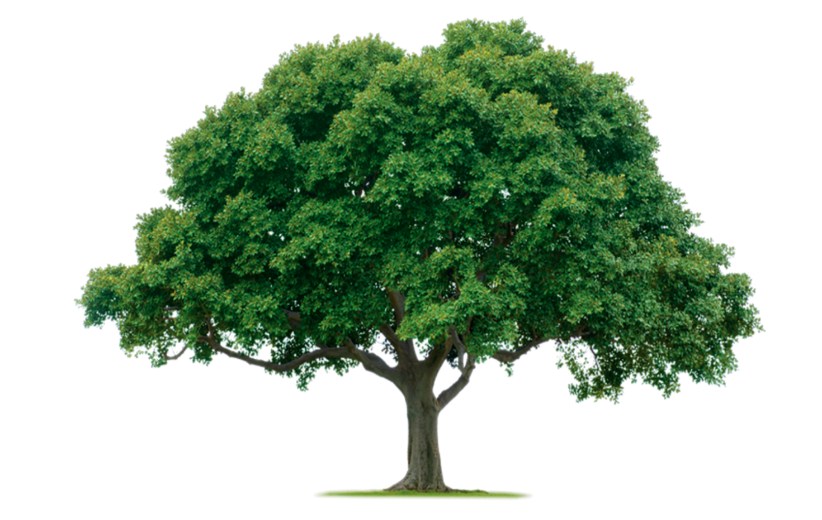
Objective
In an NC State introductory biology class for non-majors, student teams collect data about dozens of trees on campus.
Data Collection of Trees
Community Science Projects
Participating Universities
STEM Interest

Slide 4
Problem
Data Collection
Permissions, Accuracy
Data Representation
Temporal, Graphics, Comparisons
Map Navigation
Zoom Levels, Interaction
Intuitive Tree clustering and finding

Slide 5
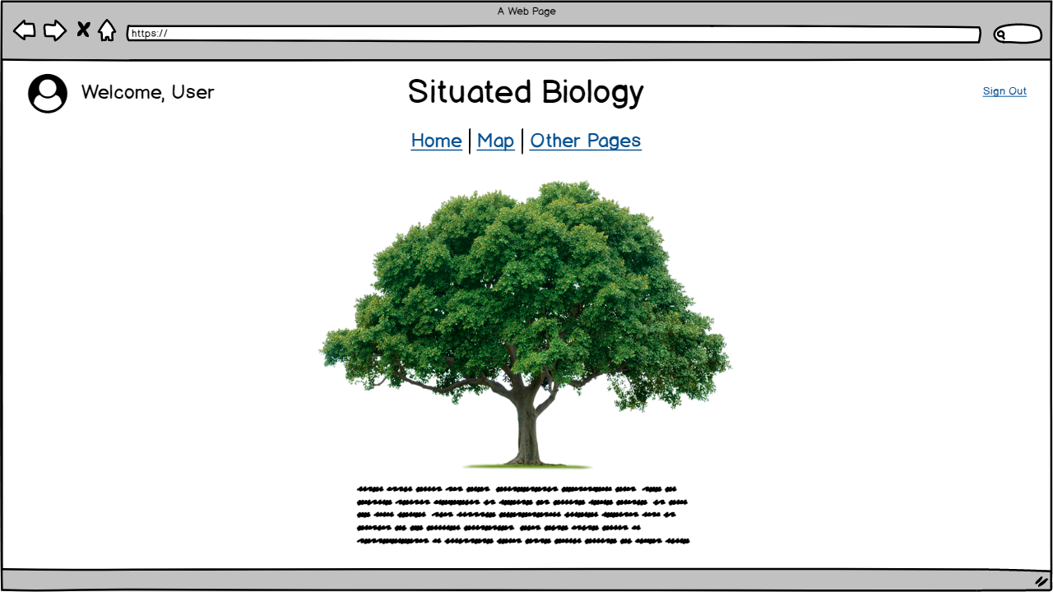
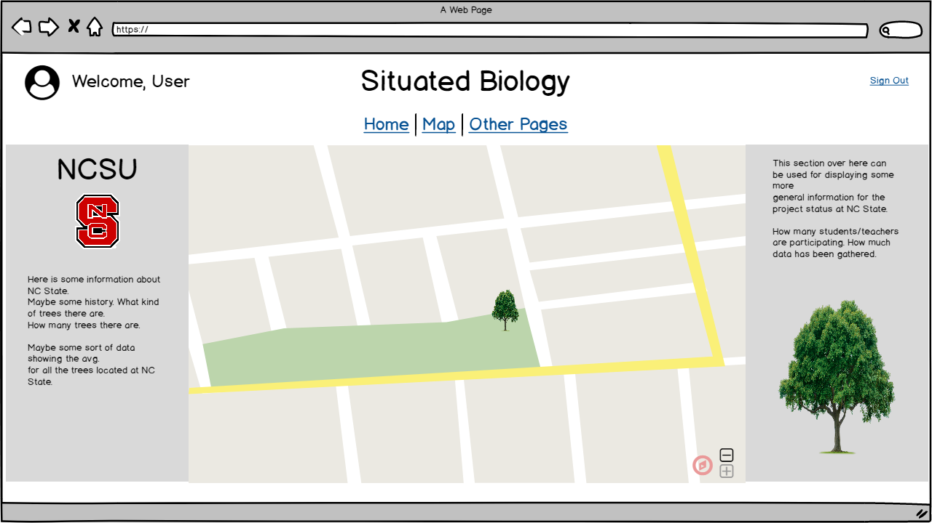
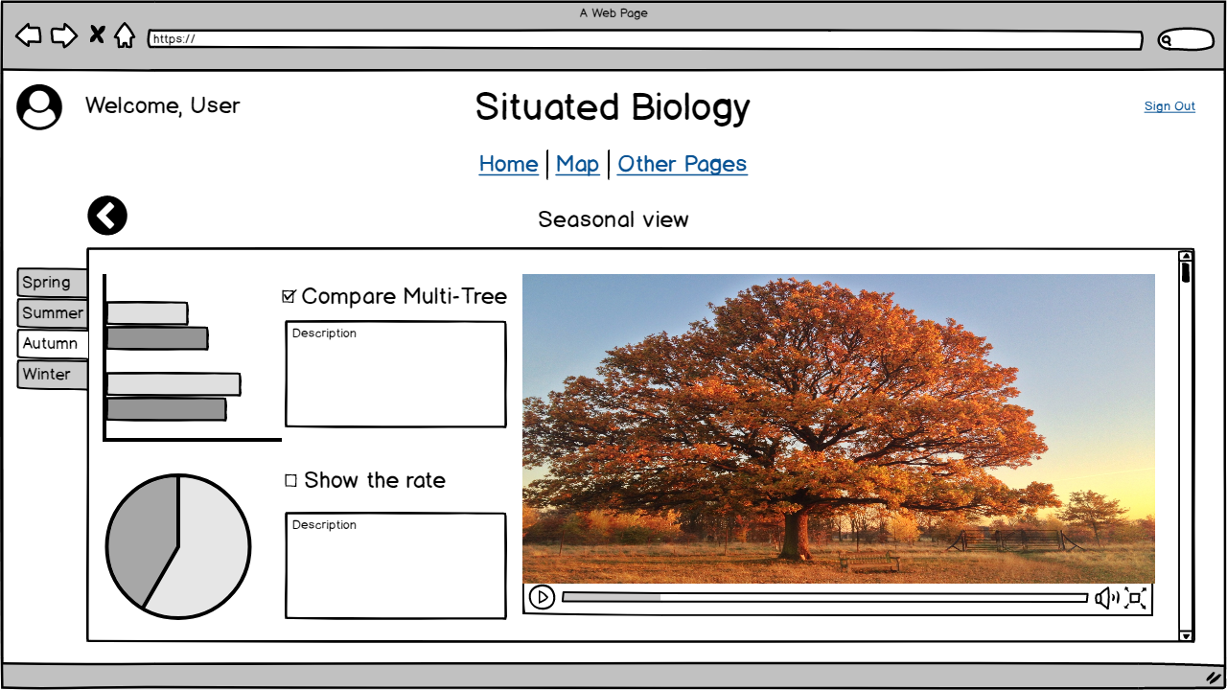
Solution
and more..

Slide 6
5 STAGES

Slide 7
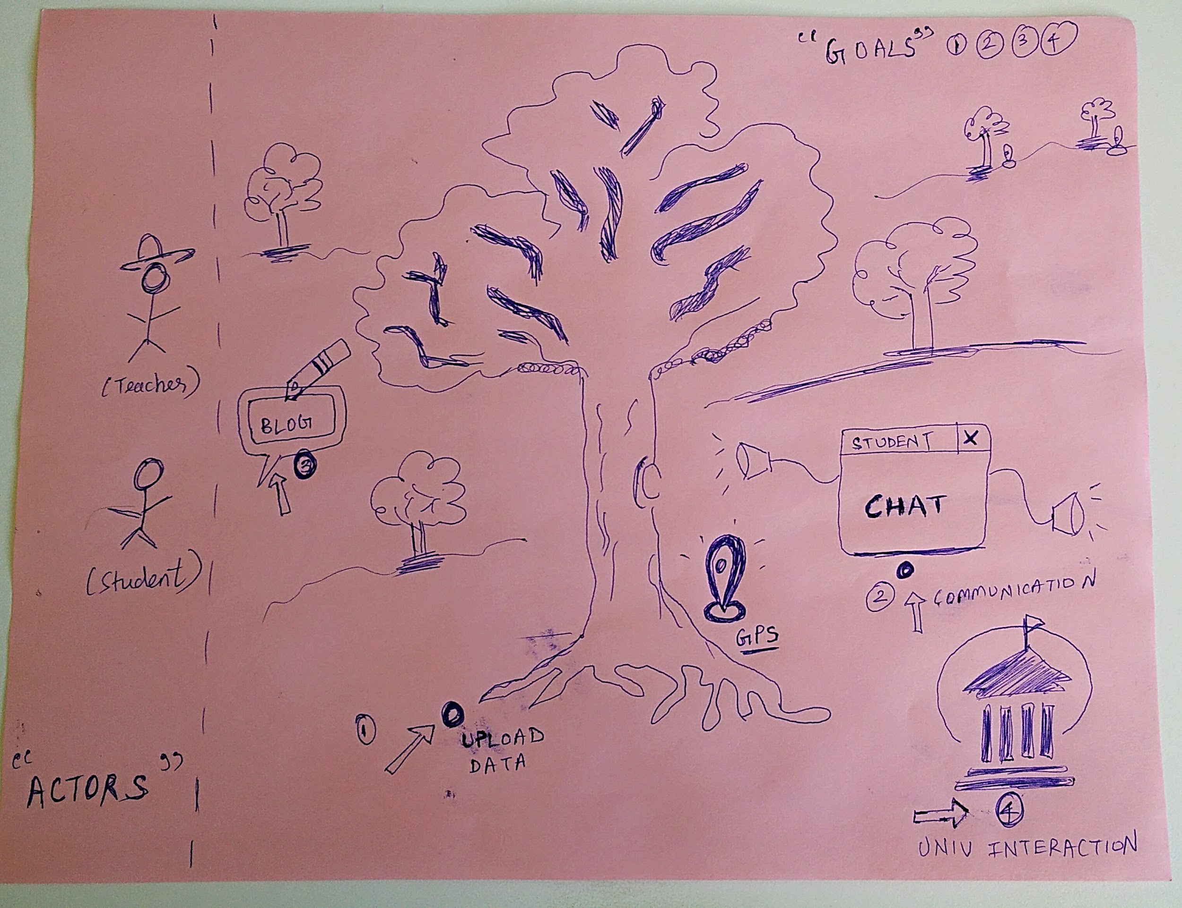
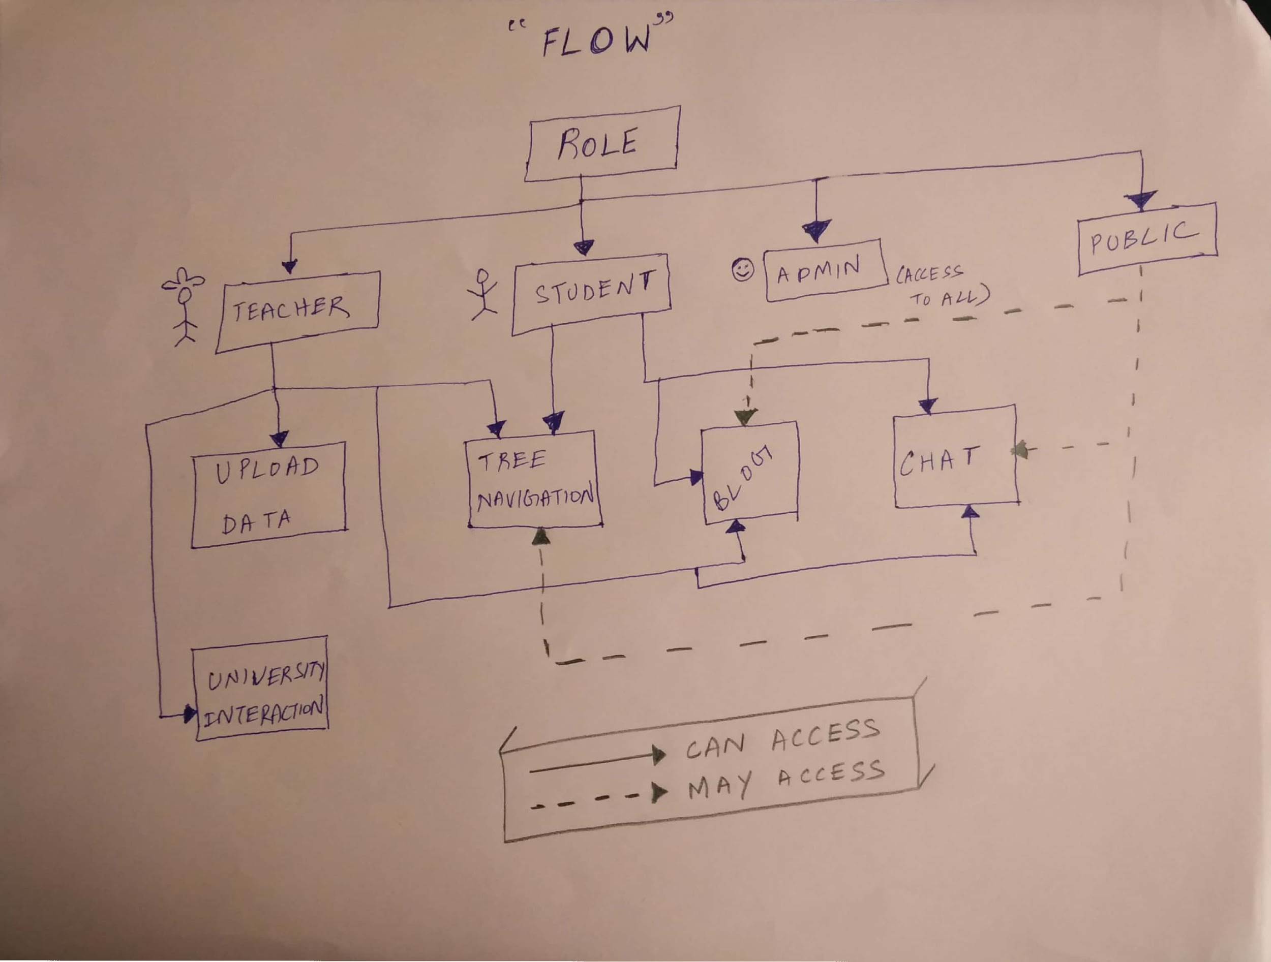
Stage 1 - Research

Slide 8
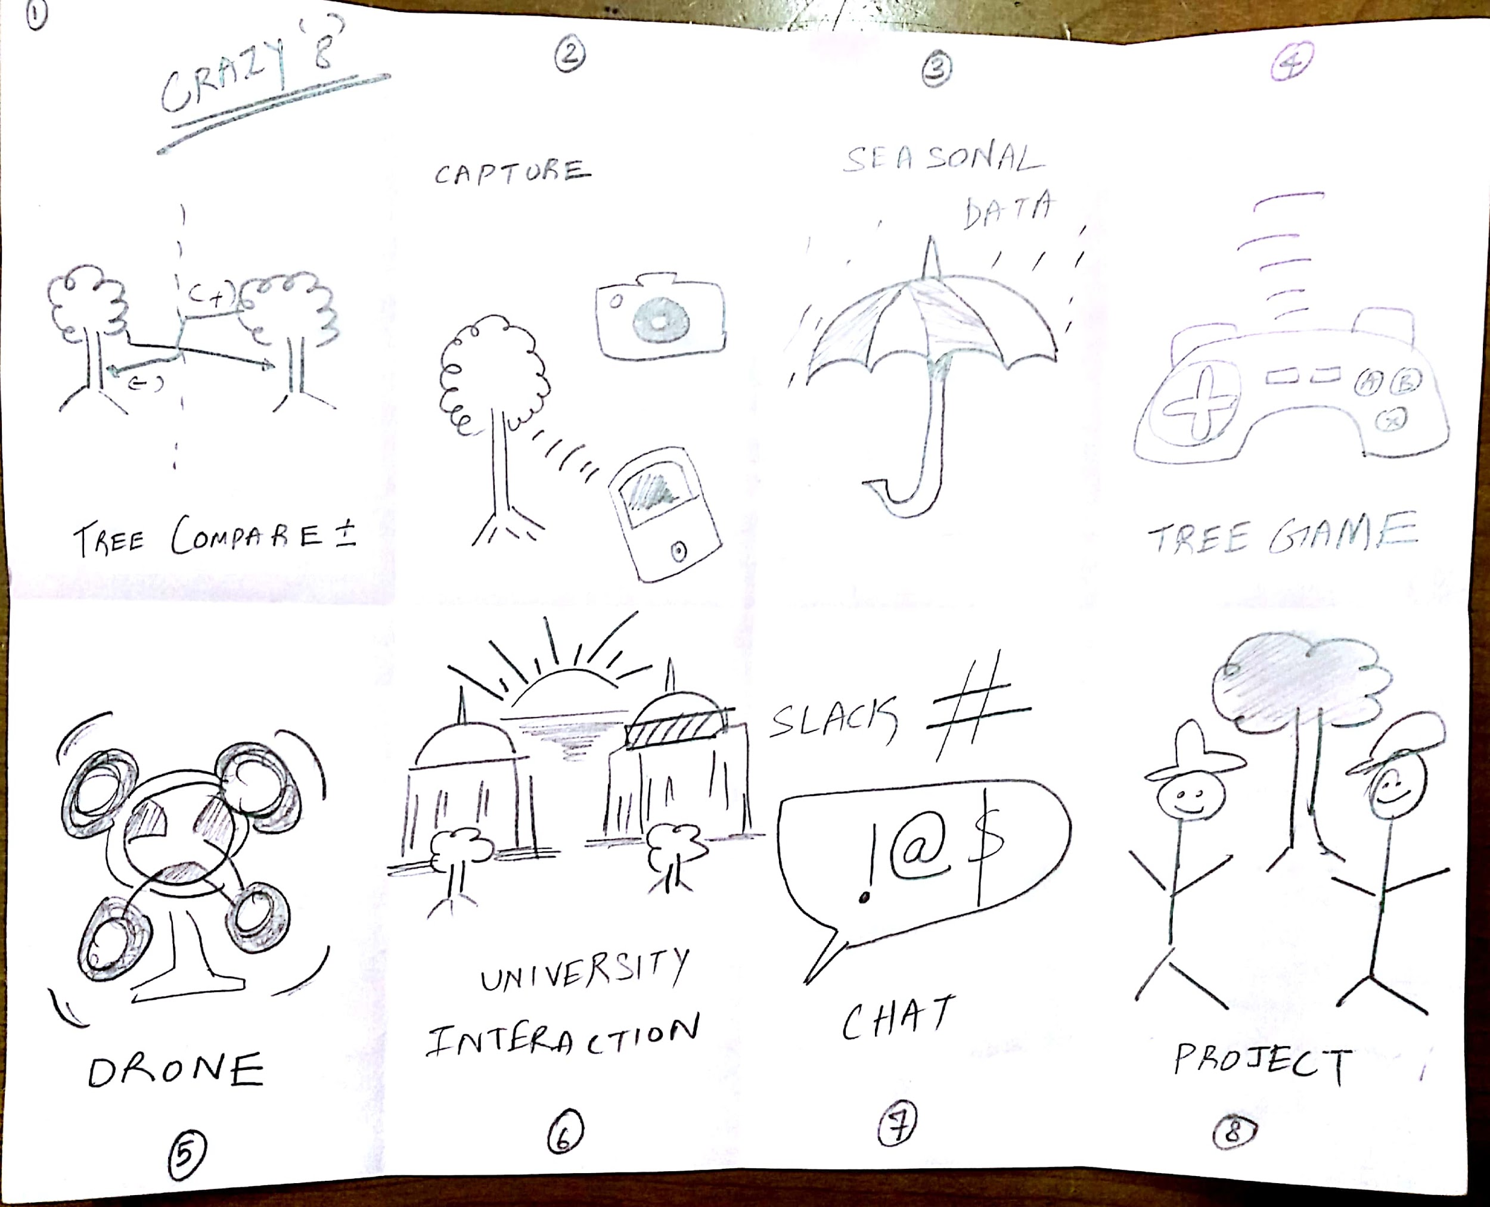
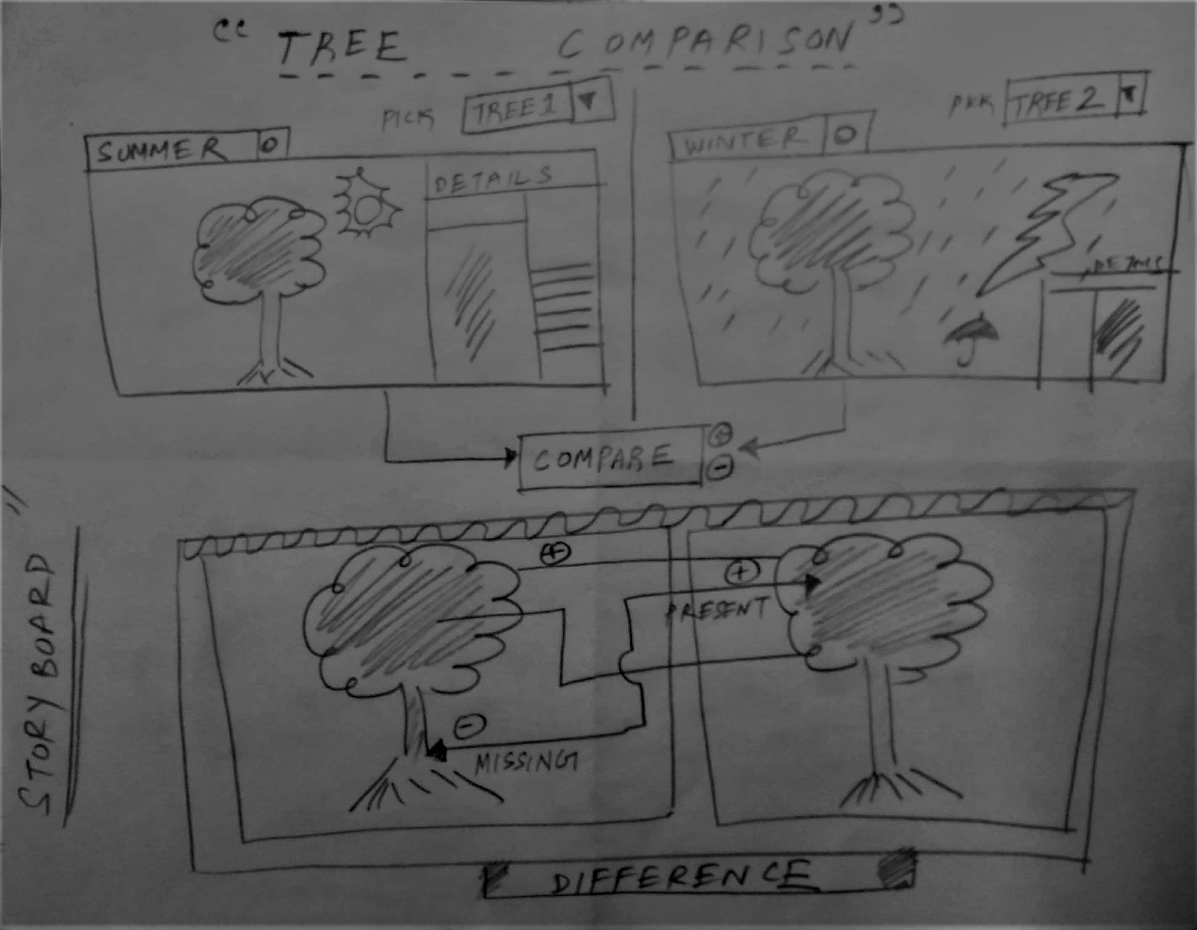
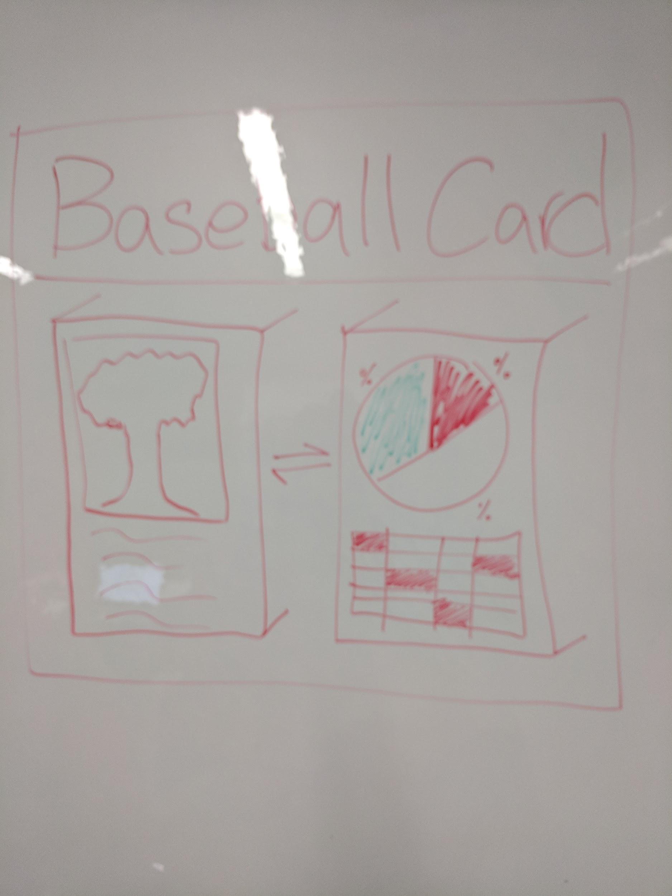
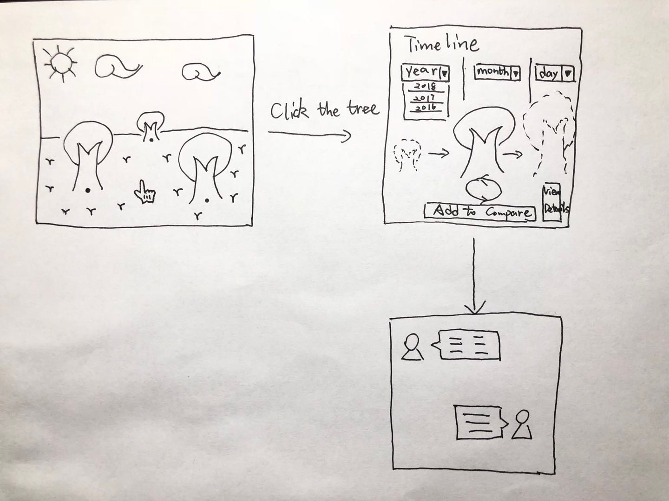
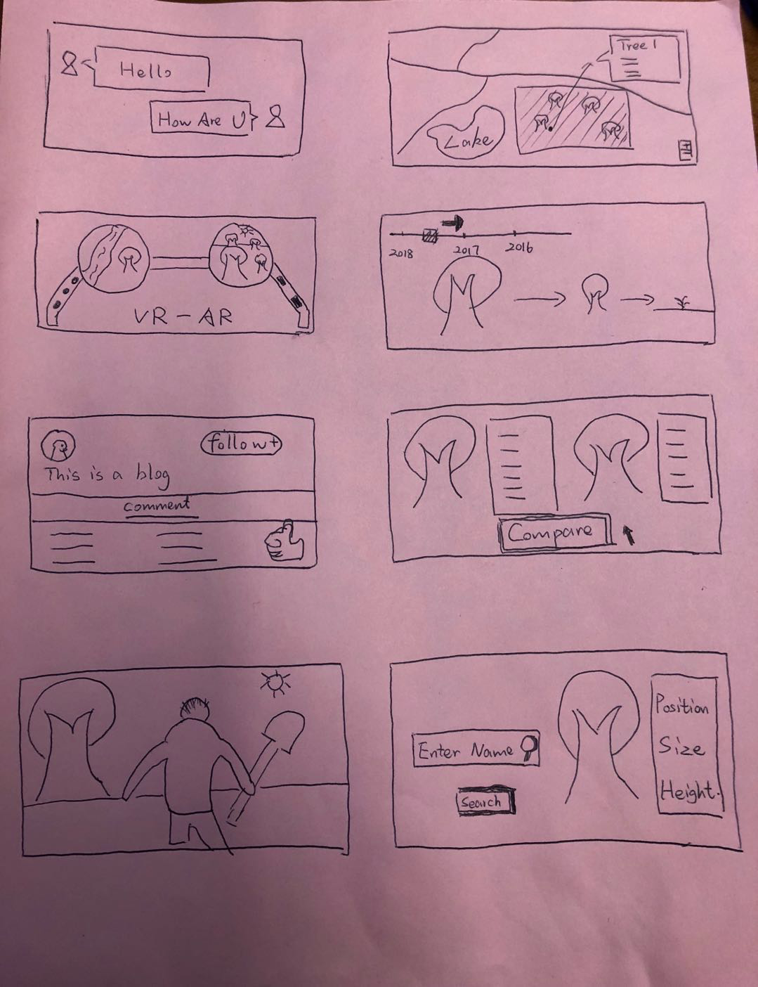
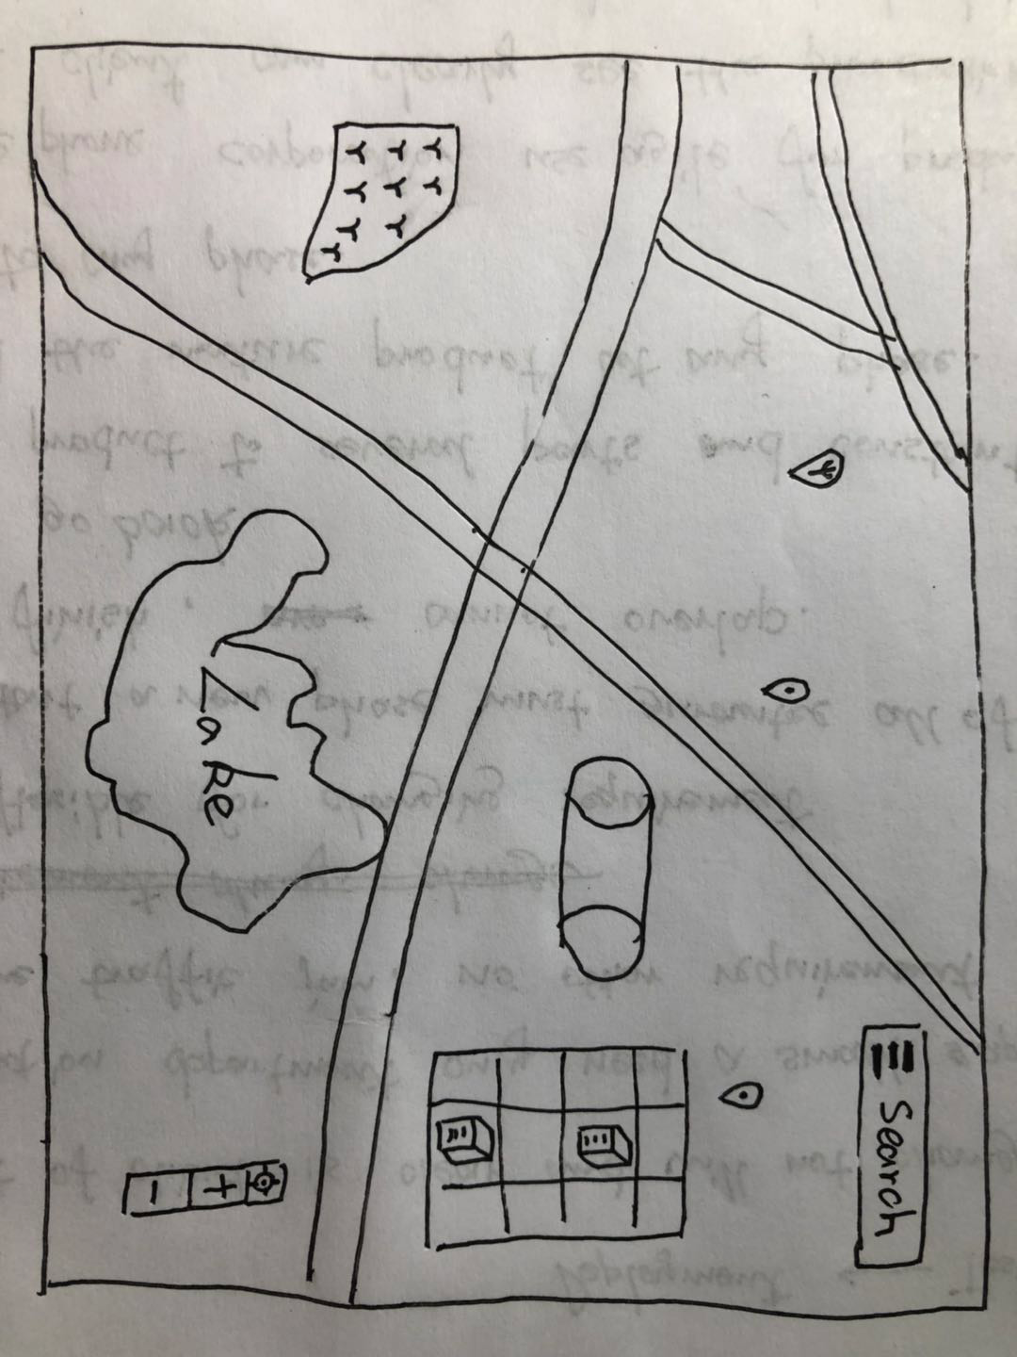
Stage 2 - Generate
and more..

Slide 9
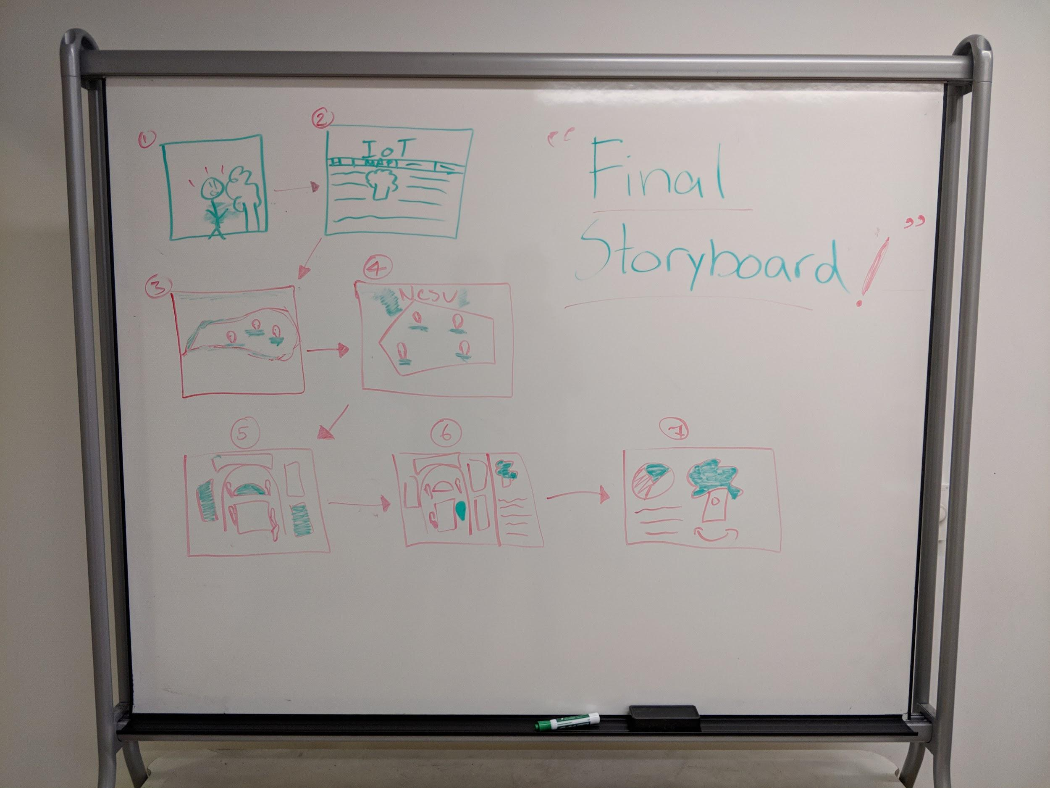
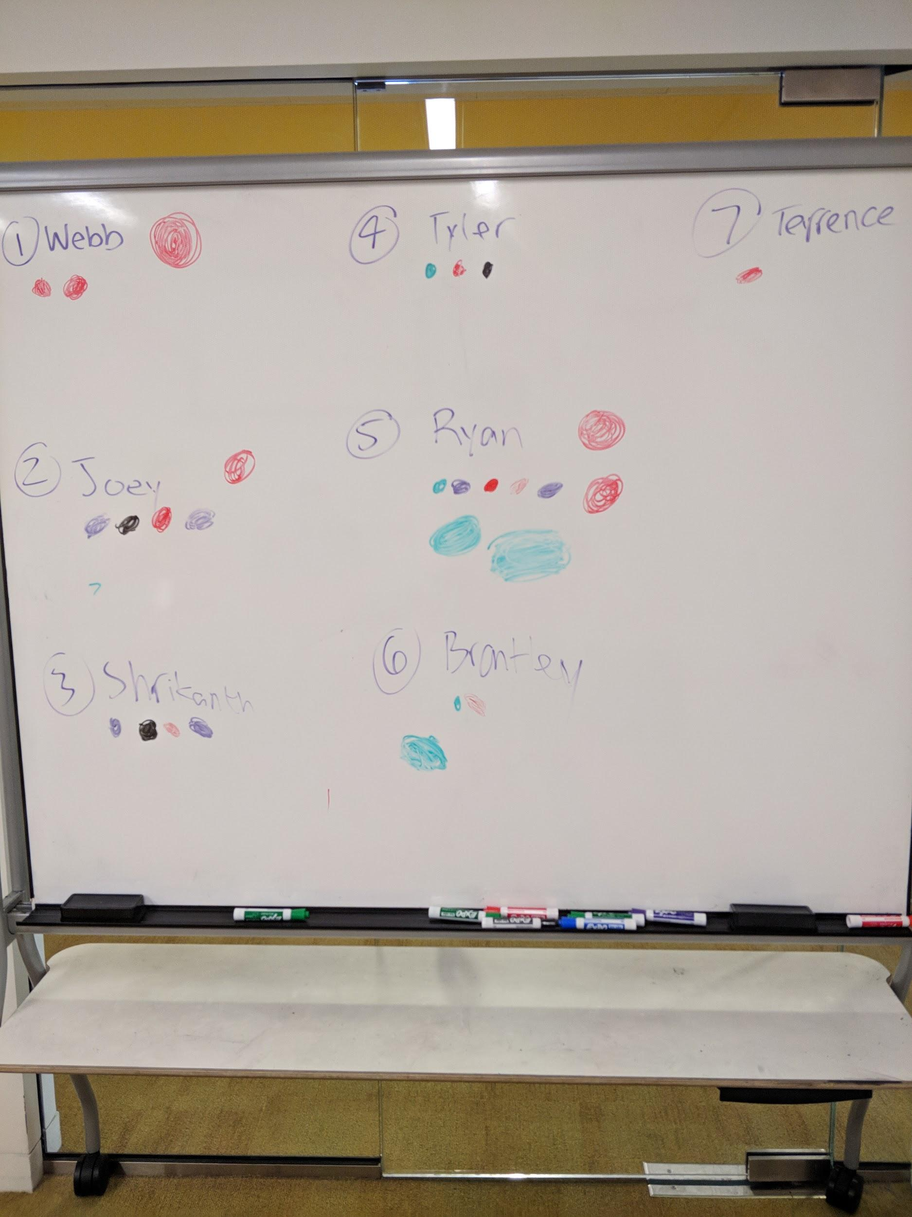
Stage 3 - Choose

Slide 10
Stage 4 - Prototype
Live Demo
https://balsamiq.cloud/sdrehj5/pmuwy1o/r9631

Slide 11
Stage 5 Evaluation
5 participants
1 Teacher
4 Students
7 core tasks
Log in
Look at the details for a tree at NCSU
Look at the comparison between two trees
Look at the timeline/historical data for a tree
Continue to the Seasonal View page and cycle through the seasons
Examine the 3D model of a tree
Download the timeline data
Notes:
Things that were good
Predominantly users were smoothy able to register and login.
The participants appreciated the overall look and feel of the website.
Timeline is good: to the point and easy to remember
3d model is nicely presented, has limited information, focused on user.
Things to Improve
Confused between two download buttons.
It took significant time for users to figure out tree compare view.
Reduce textual information on the screen
Give better suggestions and links and explain

Slide 12
Recommendations
Reevaluate position, orientation, and size of a few components (e.g. map)
Comparison page for different trees
More pages for additional data such as insects
Notes:
Gates didn’t like how the map “hogged” the spotlight from trees
more functionality for being able to compare trees
accommodate additional data

Slide 13
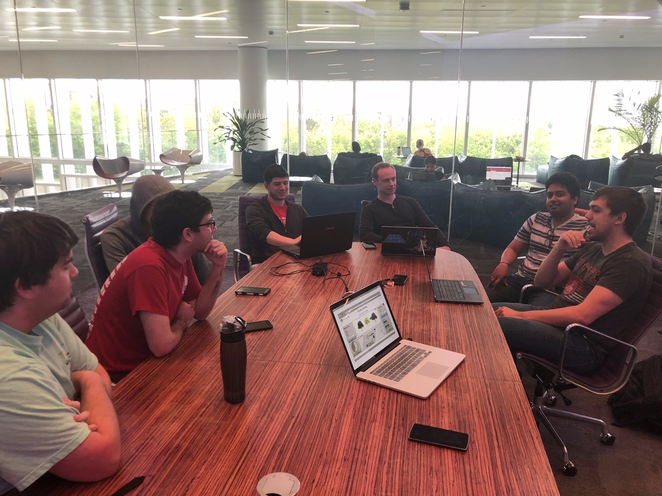
Questions ?

Slide 14
Thank You
Team :
Webb Chawla, Tyler Albert, Brantley Collins, Chengyuan LIU ,Joseph Ly, Ryan Mee & Shrikanth Narayanaswamy Chandrasekaran

